Slide 1


PEGASUS
GROUP 3

Slide 2


OUR TEAM
Joel J Nellikkunnel - ME22BTECH11025
Mukhil M - ME22BTECH11036
Neeraj Balachandar - ME22BTECH11037
Babu Sriram - ME22BTECH11010
Ashish Sam - ME22BTECH11009
Shriram Hari - ME22BTECH11023
A Padmaprabhan - ME22BTECH11001

Slide 3
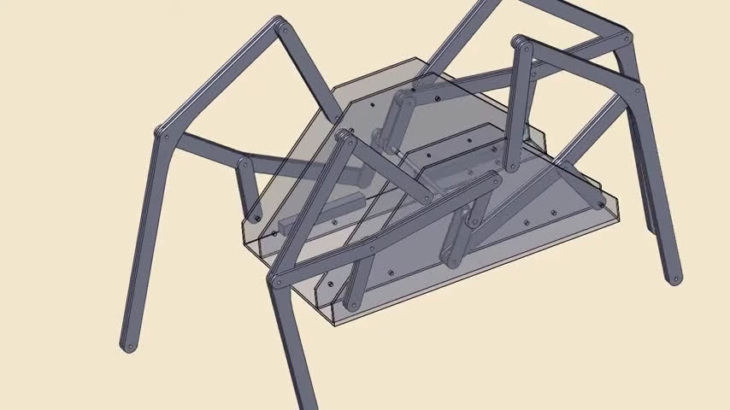
SYNTHESIS
Source: ersamia (YouTube)
Reference for walking mechanism implemented in our project

Slide 4
SYNTHESIS AND ANALYSIS

Slide 5
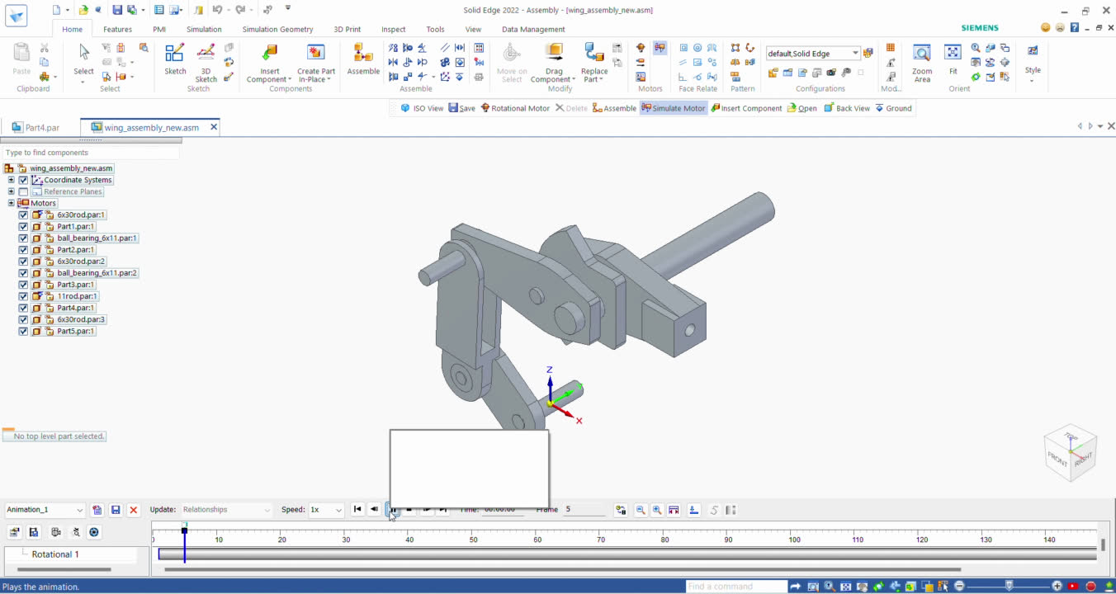
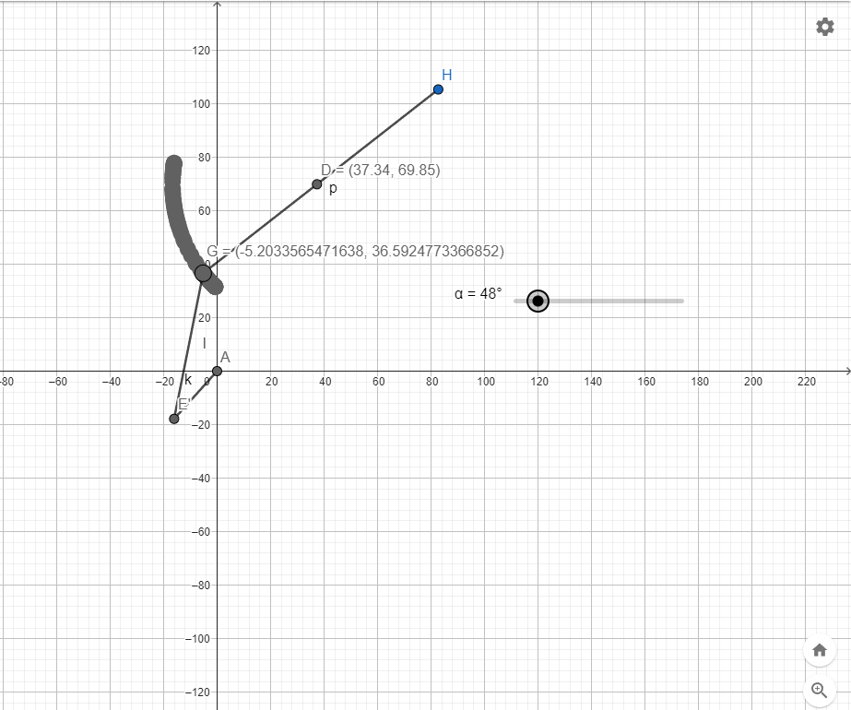
WING MECHANISM - 4 BAR
Obtaining accuracy points

Slide 6
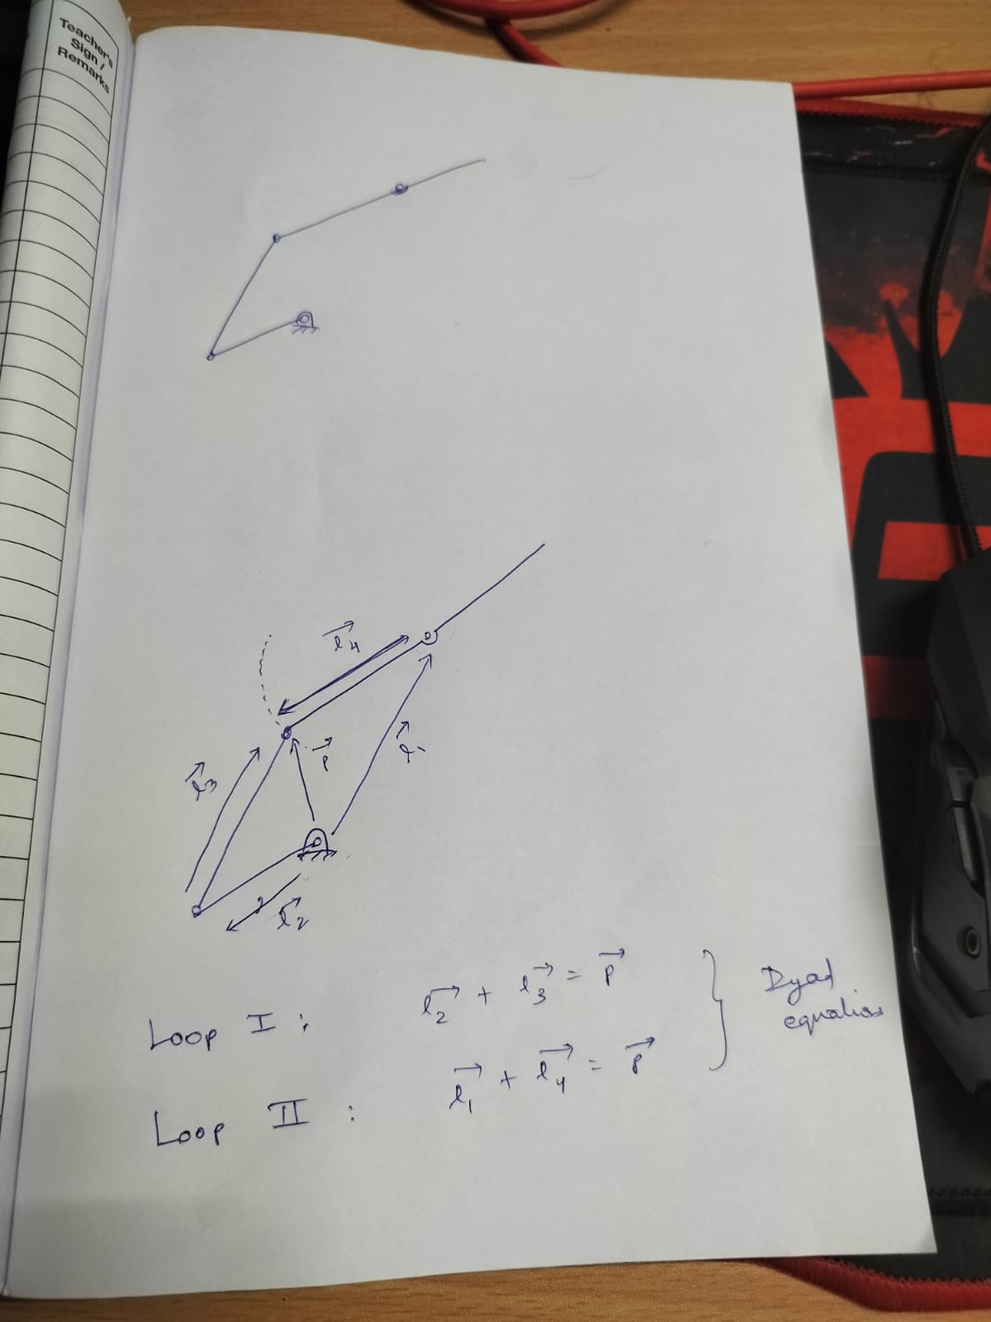
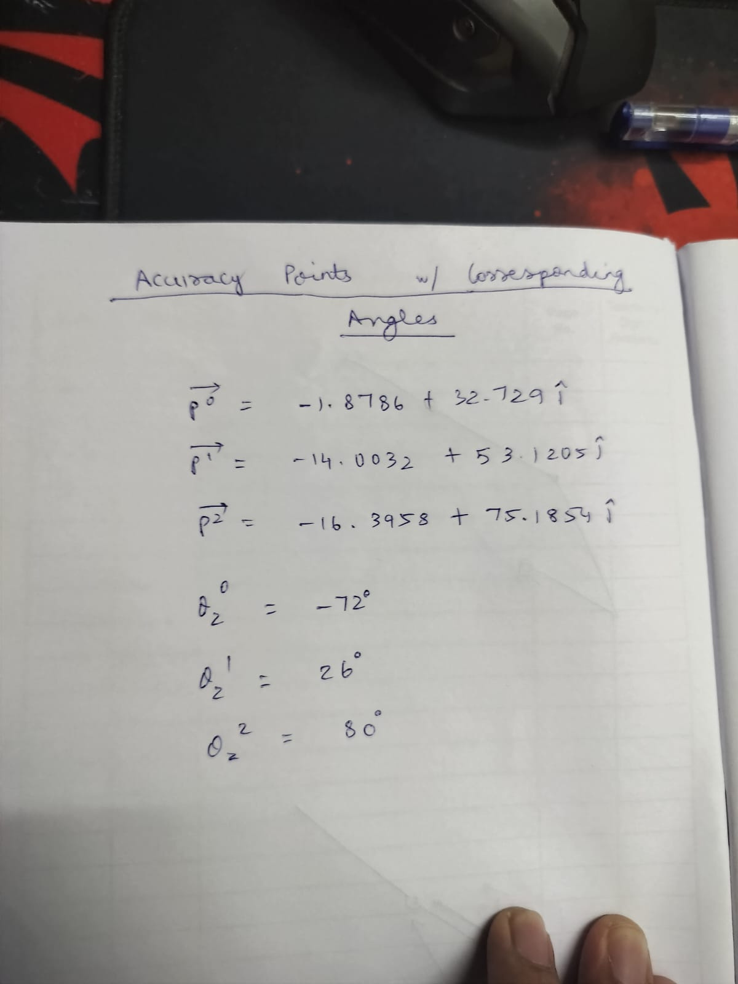
WING MECHANISM - 4 BAR
Loop Closure Equations
Accuracy points and corresponding angles

Slide 7

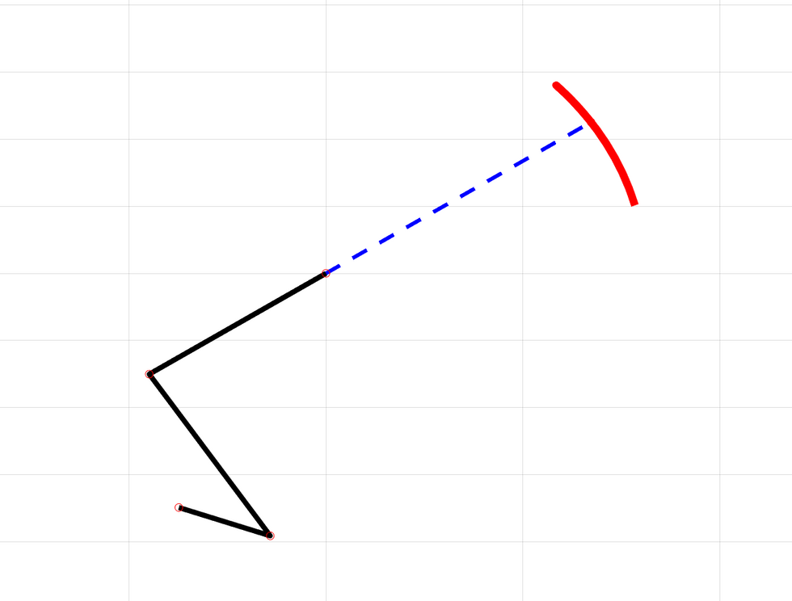
WING MECHANISM - 4 BAR
Obtained Values: ( from Conjugate Method)
l1= 79.204 mm
l2= 24.696 mm
l3= 57.17 mm
l4= 54 mm
L4
L3
L2

Slide 8
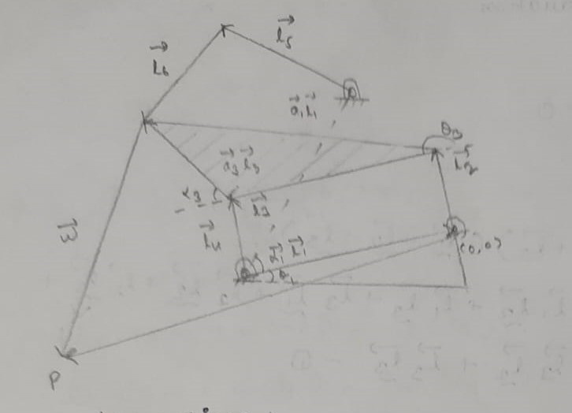
WALKING MECHANISM - 6 BAR
Loop Closure Diagram:

Slide 9
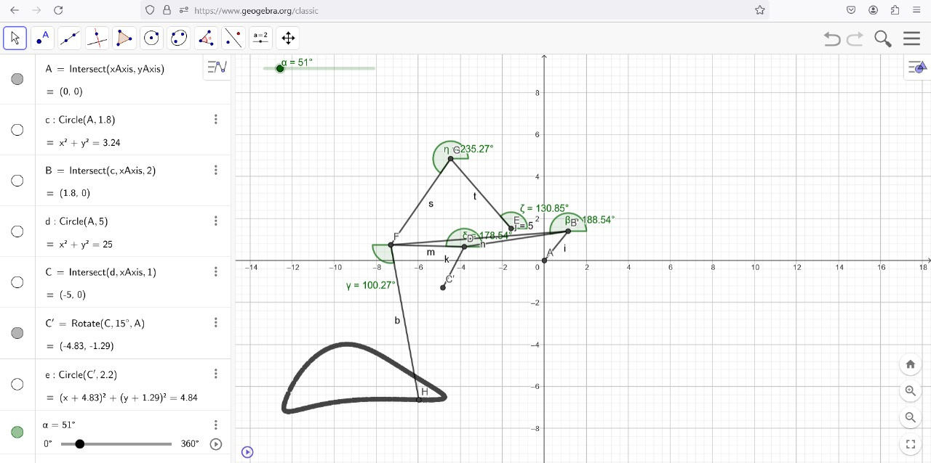
WALKING MECHANISM - 6 BAR
Obtaining accuracy points and corresponding crank angles (link lengths obtained from the reference YouTube video)

Slide 10
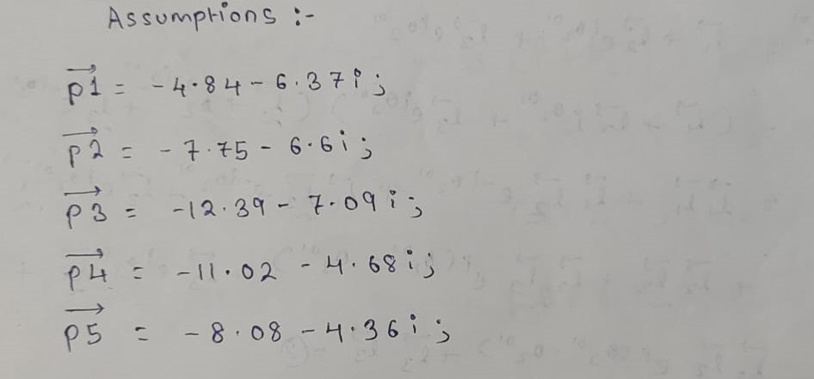
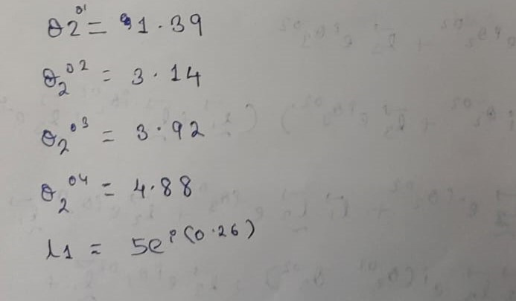
WALKING MECHANISM - 6 BAR
Accuracy points and corresponding angles:

Slide 11
WALKING MECHANISM - 6 BAR
Obtained Values [ using vpasolve() ]:
l1= 175 mm
a1.l1= 164.182 mm
l2= 62.944 mm
l3= 175.07 mm
a3.l3 = 125.171 mm
l4= 77.385 mm
l5= 152.975 mm
l6= 178.784 mm
w= 275.121 mm

Slide 12
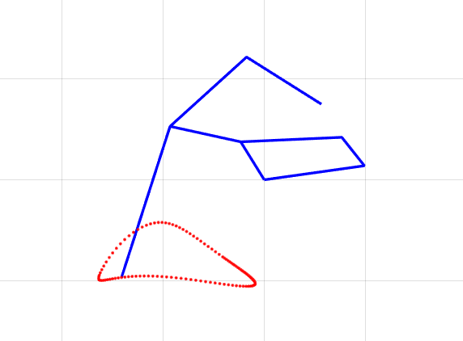
ANALYSIS ( LEG)
Wrote loop closure equations for the Klann linkage which involved finding the angles made by links 3,4,5 and 6 with x axis, with given link 2 input angles. Involved 4 equations which were solved using fsolve().
Stage 1
Stage 2
Substituting the obtained link lengths and improving the output animation.
Generating MATLAB code with guessed link lengths and angles.
Stage 3
Created a user defined function which generates the coordinates of each leg seperately by adding the given phase to it.
Klann Linkage as generated in MATLAB

Slide 13
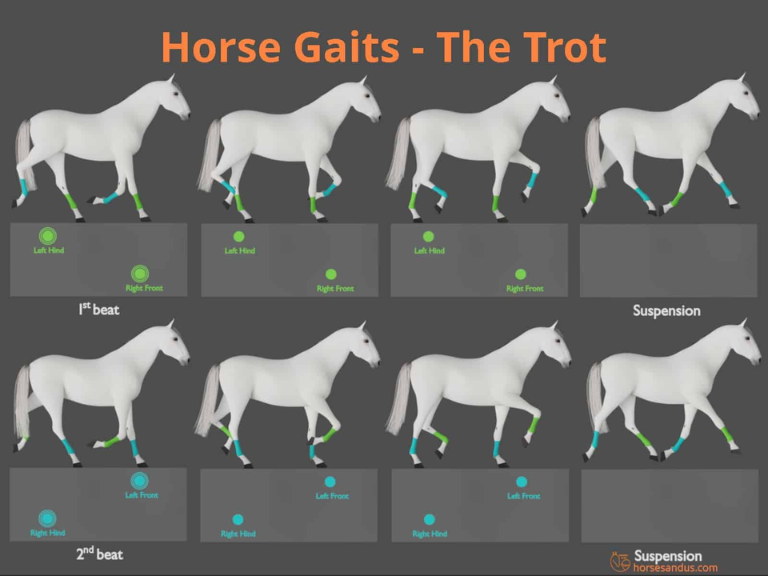
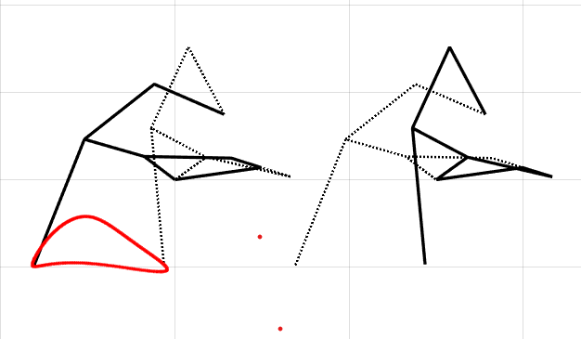
ANALYSIS ( LEG)
Source: Horses and Us (YouTube)

Slide 14
GEAR TRAIN

Slide 15
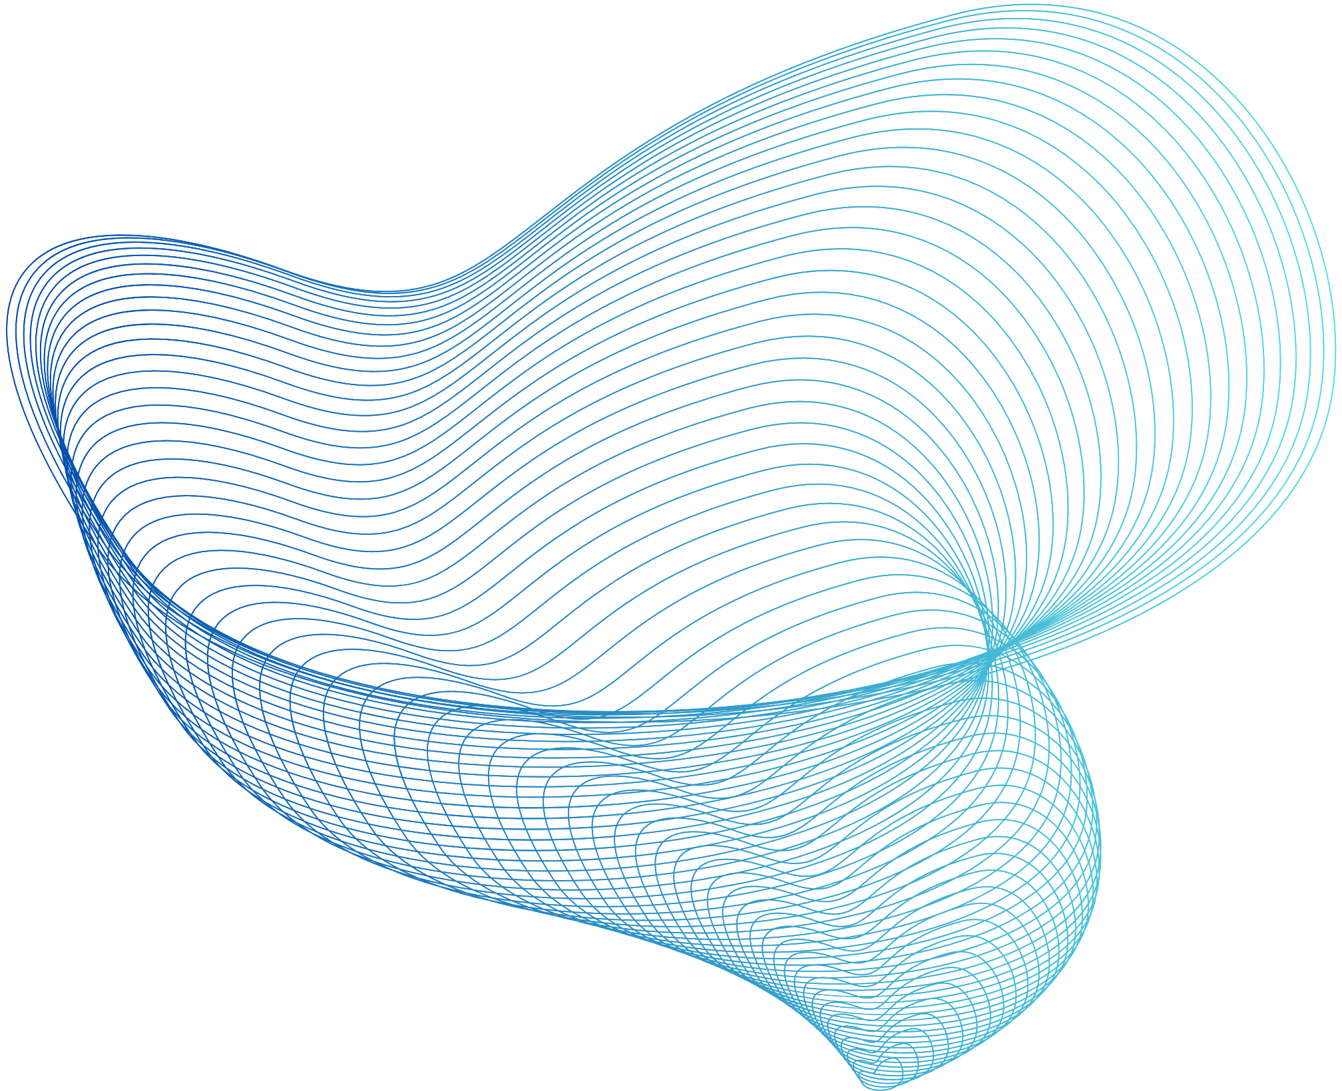
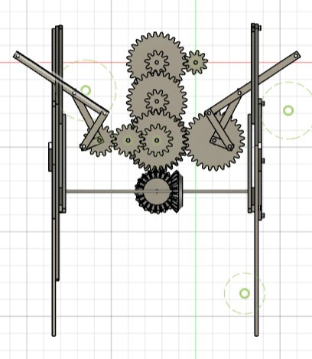
GEAR TRAIN
REDUCTION RATIO:
Wing Mechanism : 1 : 22
Walking Mechanism : 1 : 14

Slide 16
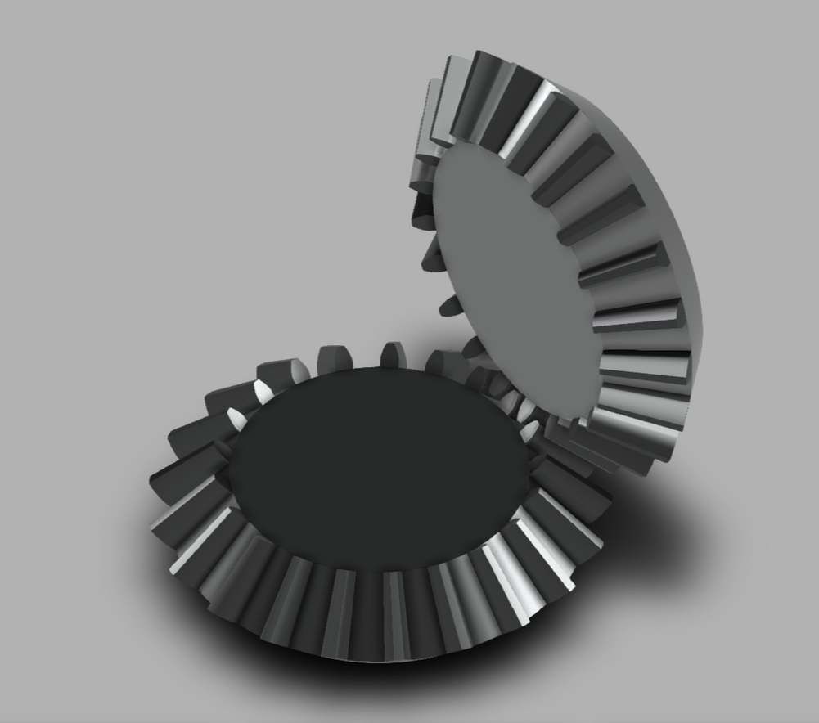
GEAR TRAIN
Tredgold's approximation aids in synthesizing bevel gears for a given module value and pitch circle radius by ensuring an integral number of teeth matches these parameters for proper meshing of gears with an involute profile.
Bevel Gear as designed in Fusion

Slide 17
CAD MODELLING
AND SIMULATION

Slide 18
CHALLENGES FACED AND LIMITATIONS

Slide 19
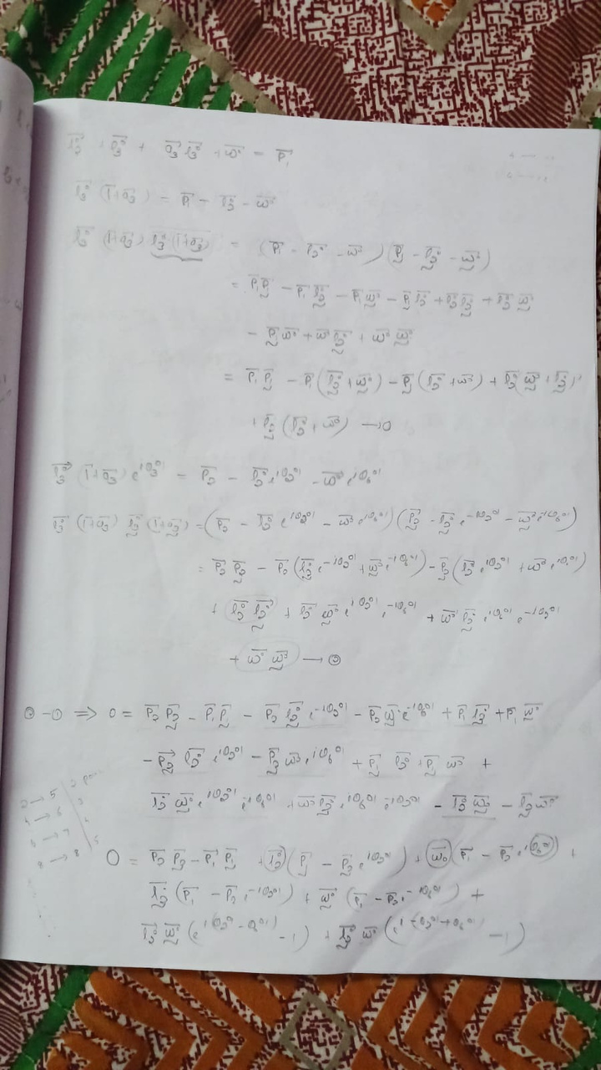
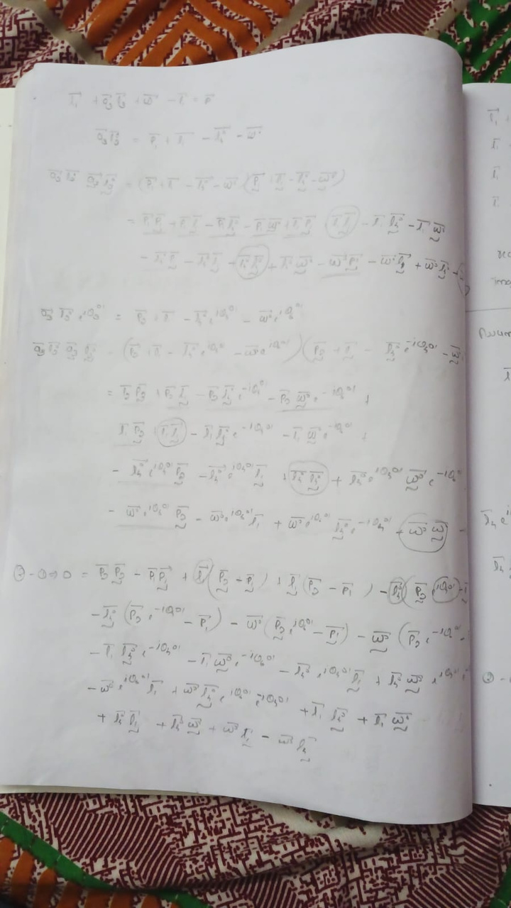
A. SYNTHESIS OF 6 BAR : Attempt to synthesize the link lengths by solving the equations without assuming any link lengths - vpasolve() failed to converge

Slide 20
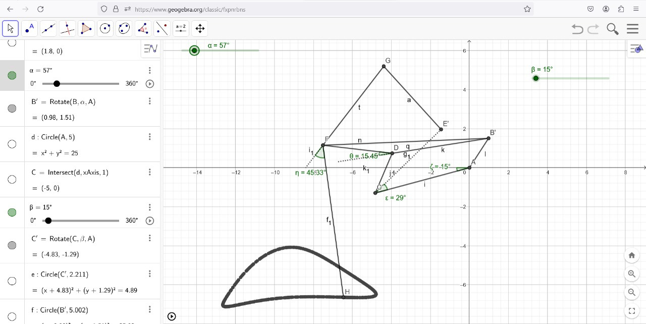
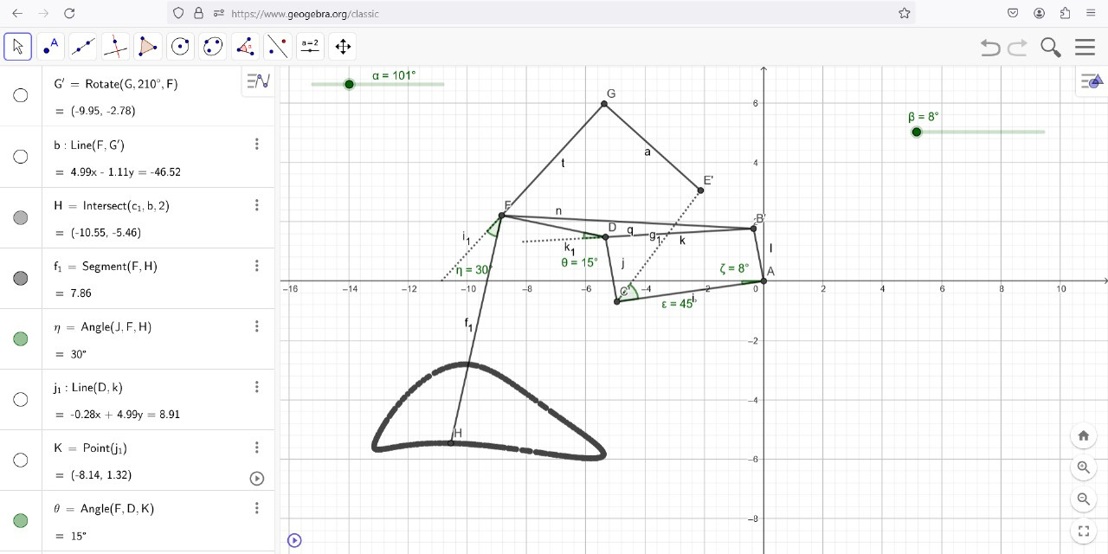
A. SYNTHESIS OF 6 BAR :
Undesirable path obtained (hence modified values of angles)
WITH REFERENCE LINK LENGTHS
WITH OBTAINED LINK LENGTHS
WITH MODIFIED ANGLES

Slide 21
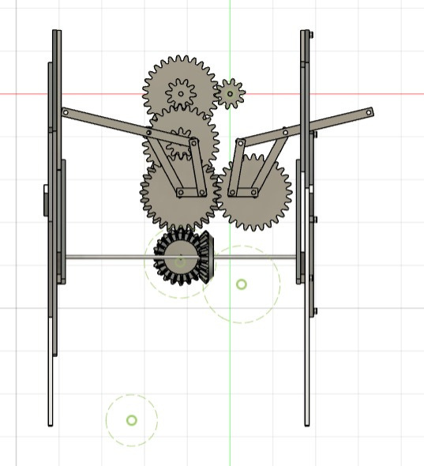
B. GEAR TRAIN :
When assembled, the corresponding gears for the wings were not aligned thus we had to add two additional gears to the system.
WING GEARS- NOT ALIGNED PROPERLY
AFTER ADDING ADDITIONAL GEARS

Slide 22
CONTRIBUTIONS
Synthesis: Mukhil, Shriram, Ashish
Gear Train: Joel, Babu Sriram
Analysis: Padmaprabhan, Neeraj
CAD Modelling: Joel, Neeraj, Shriram, Ashish
Slides: Babu Sriram, Ashish

Slide 23
REFERENCES
Six bar linkage mechanism
Klann Linkage Optimizer
Horse Gaits - The Trot
How to model Bevel Gears using Tredgold's Approximation

Slide 24
THANK YOU!

